Slide 1


Business and Information Technology
BSBCRT404 Apply advanced critical thinking to work processes Sessions 15 & 16

Slide 2
Session 15 & 16 Topics
Seeking Feedback & Critical Thinking
Patterns / modes of thinking and how this can help with problem solving
Bloom’s Taxonomy and Video
The Power of Thought

Slide 3
Seeking Feedback & Critical Thinking
CT is often used effectively during the decision making process
Why should a critical thinker seek feedback? (discuss)
Inclusivity and camaraderie
Better / different insights
Check assumptions
Explain proposal clearly
Seek feedback and remain open-minded
Assess feedback and alter if required
Repeat process?

Slide 4
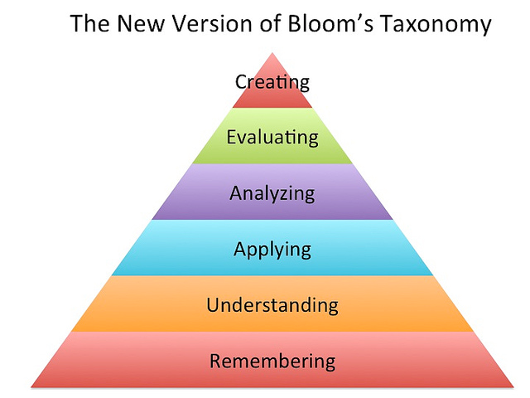
Patterns of Thinking and Problem Solving
When evaluating a solution or proposal, be aware of the level of thinking you are using ….
This can improve the effectiveness of your thinking and therefore any subsequent decisions

Slide 5
Remembering
When you are skilled in remembering, you can recognise or recall knowledge you’ve already gained, and you can use it to produce or retrieve or recite definitions, facts, and lists.
Remembering may be how you studied in grade school or high school, but college will require you to do more with the information.
Examples include: identify · relate · list · define · recall · memorize · repeat · record · name

Slide 6
Understanding
Understanding is the ability to grasp or construct meaning from oral, written, and graphic messages.
Each college course will introduce you to new concepts, terms, processes, and functions. Once you gain a firm understanding of new information, you’ll find it easier, perhaps later, to comprehend how or why something works.
Examples include: restate · locate · report · recognize · explain · express · identify · discuss · describe · discuss · review · infer · illustrate · interpret · draw · represent · differentiate · conclude

Slide 7
Applying
When you apply, you use learned material (or you implement the material) in new and concrete situations.
In college you will be tested or assessed on what you’ve learned in the previous levels. You will be asked to solve problems in new situations by applying understanding in new ways. You may need to relate abstract ideas to practical situations.
Examples include: apply · relate · develop · translate · use · operate · organize · employ · restructure · interpret · demonstrate · illustrate · practice · calculate · show · exhibit · dramatize

Slide 8
Analysing
When you analyse, you have the ability to break down or distinguish the parts of material into its components, so that its organizational structure may be better understood.
At this level, you will have a clearer sense that you comprehend the content well. You will be able to answer questions such as what if, or why, or how something would work.
Examples include: analyse · compare · probe · inquire · examine · contrast · categorize · differentiate · contrast · investigate · detect · survey · classify · deduce · experiment · scrutinize · discover · inspect · dissect · discriminate · separate

Slide 9
Evaluating
With skills in evaluating, you are able to judge, check, and even critique the value of material for a given purpose.
At this level in TAFE you should be able to think critically. Your understanding of a concept or discipline should be sound. You should be able to present and defend opinions.
Examples include: judge · assess · compare · evaluate · conclude · measure · deduce · argue · decide · choose · rate · select · estimate · validate · consider · appraise · value · criticize · infer

Slide 10
Creating
With skills in creating, you are able to put parts together to form a coherent or unique new whole. You can reorganize elements into a new pattern or structure through generating, planning, or producing.
Creating requires originality and inventiveness. It brings together all levels of learning to theorize, design, and test new products, concepts or functions.
Examples include: compose · produce · design · assemble · create · prepare · predict · modify · plan · invent · formulate · collect · generalize · document combine · relate · propose · develop · arrange · construct · organize · originate · derive · write · propose

Slide 11
Bloom’s Taxonomy (Online video follows 4 minutes)

Slide 12

https://youtu.be/Qfp3x_qx5IM

Slide 13
The Power of Thought - Metacognition
From Bloom’s taxonomy of learning skills, you can see that thought and thinking can be understood as patterns—systems and schemes within the mind. There is order and structure in the way we think and in the way we process and internalise information.
As we look at patterns of thought, we can also think about the power of thought.
For example, the act of thinking—just thinking—can affect not only the way your brain works but also its physical shape and structure.

Slide 14
In these sessions we looked at:
The importance of seeking feedback
Patterns of Thinking and Problem Solving
Bloom’s Taxonomy
The power of thought and how being aware of your thinking (metacognition) can help you

Slide 15
Further Reading, Activities and Assessments
Open the Workbook and read pages 85 – 90
Complete Activity 13 in Workbook (individually or as a class)
Continue AT02 assessment question 13
Continue AT02 Task 2
Continue AT01 assessment questions

